Slide 1
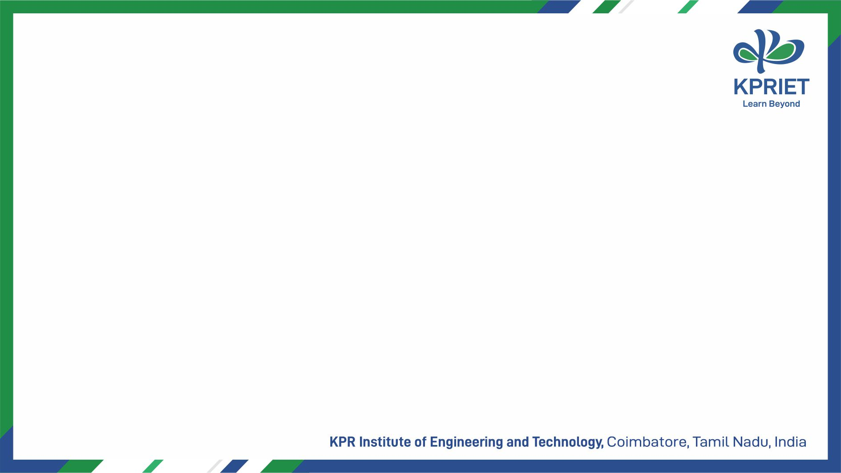
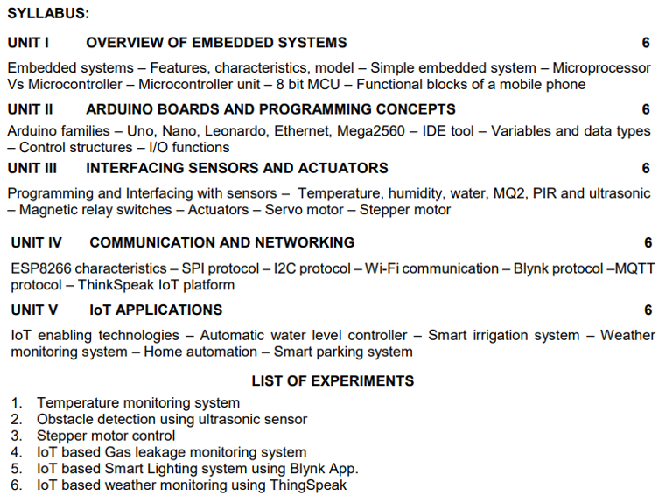
Activities
U21ECG04
Internet of Things and it’s Applications

Slide 2
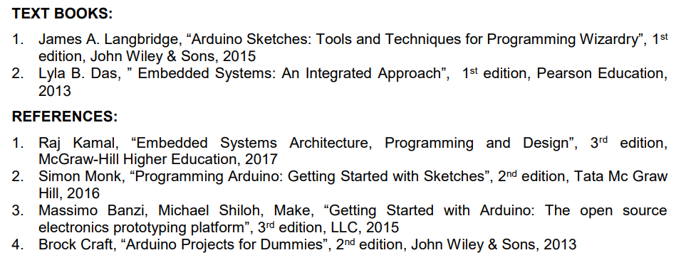
Activities
U21ECG04
Internet of Things and it’s Applications

Slide 3
Activities
Unit 1
Overview of Embedded Systems
Book: Lyla B. Das, ” Embedded Systems: An Integrated Approach”, 1st edition, Pearson Education, 2013
PDF: Book 02
Book: Raj Kamal, “Embedded Systems Architecture, Programming and Design”, 3rd edition, McGraw-Hill Higher Education, 2017
PDF: Book 03

Slide 4
Activities
Unit 1
Overview of Embedded Systems
Embedded Systems
Definition: An embedded system is a system that has embedded software and computer hardware, making it dedicated to an application or specific part of an application, product, or larger system.
Embedded Software: The specific software programs that control the system's operations and perform the dedicated tasks.
Computer Hardware: The physical components, including microcontrollers or microprocessors, memory, input/output interfaces, and other necessary peripherals.

Slide 5
Activities
Unit 1
Overview of Embedded Systems
1.1 Applications of Embedded Systems
The application domain of embedded systems percolates every element of modern life it will be easier to understand its features once we take a tour of the world of embedded systems. The following is a list:
Consumer electronics: Cameras, music players, TVs, DVD players, microwave ovens, washing machines, refrigerators and remote controls.
Household appliances/home security systems: Air conditioners, intruders and fire alarm systems.
Automobile controls: Anti-lock braking system, engine and transmission control, door and wiper control, etc.
Handheld devices: Mobile phones, PDAs, MP3 players, digicams, etc.
Medical equipments: Scanners, ECG and EEG units, testing and monitoring equipments.
Banking: ATMs, currency counters, etc.
Computer peripherals: Printers, scanners, webcams, etc.

Slide 6
Activities
Unit 1
Overview of Embedded Systems
1.1 Applications of Embedded Systems
Networking: Routers, switches, hubs, etc.
Factories: Control, automation, instrumentation and alarm systems.
Aviation: Airplane controls, guidance and instrumentation systems.
Military: Control and monitoring of military equipment's.
Robotics: Used in factories, household, toys and hobby-related activities.

Slide 7
Activities
Unit 1
Overview of Embedded Systems
2. Features & Characteristics of Embedded Systems
It should have one or a small set of functions which it is expected to perform efficiently.
It should be designed for low-power dissipation, because many systems are battery powered.
It has limited memory and limited number of peripherals.
Applications are not meant to be alterable by the user.
Many of them are not accessible directly, that is, they may be part of the control unit of a larger system, so no interference in operation is possible.
They need to be highly reliable.
Many of them need to operate with time constraints.

Slide 8
Activities
Unit 1
Overview of Embedded Systems
2.1 Constraints of Embedded Systems
An embedded system is designed with three main constraints in mind:
  Available System Memory
  Available Processor Speed
  Need to Limit Power Dissipation: This is crucial when the system runs continuously in cycles of 'wait for events', 'run', 'stop', 'wake-up', and 'sleep'.
The system design of an embedded system also has constraints regarding performance, power, size, and design and manufacturing costs.

Slide 9
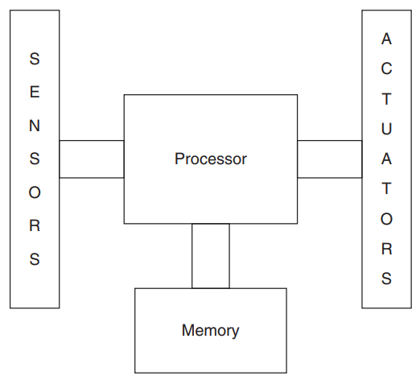
Activities
Unit 1
Overview of Embedded Systems
2.2 Model of an Embedded System
An embedded system is a specialized computing system designed to perform specific tasks. At its core, it has four main components:
Processor: The central part of the system that handles calculations and executes instructions. It processes the data received from sensors and makes decisions based on that data.
Sensors: These are devices that collect data from the environment. For example, a temperature sensor measures temperature, or a camera captures images. The sensors provide the input data that the system needs to function.

Slide 10
Activities
Unit 1
Overview of Embedded Systems
2.2 Model of an Embedded System
Actuators: These are components that perform actions based on the processor’s instructions. For example, if a sensor detects that a room is too hot, the actuator might turn on a fan to cool the room. Actuators convert the processed data into physical actions.
Memory: This is used to store both the data from sensors and the instructions for the processor. It holds the program that controls how the system operates and processes the data.

Slide 11
Activities
Unit 1
Overview of Embedded Systems
2.2 Model of an Embedded System
How It Works:
Data Collection: Sensors gather data from the environment.
Data Processing: The processor takes this data and processes it according to the instructions in its program.
Action Execution: Based on the processed data, the processor sends commands to actuators, which then perform actions to address the real-world problem.
In summary, an embedded system uses sensors to collect data, processes this data with its processor, and uses actuators to carry out actions based on the processed information.

Slide 12
Activities
Unit 1
Overview of Embedded Systems
3. Simple Embedded System
3.1 Components of Computer System
A computer is a system that has the following or more components:
A microprocessor
A large memory of the following two kinds:
  (a) Primary memory (semiconductor memories: Random Access Memory (RAM), Read Only Memory (ROM), and fast accessible caches)
  (b) Secondary memory (magnetic memory located in hard disks, and cartridge tapes, optical memory in CD-ROMs or memory sticks in mobile computers), using which different user programs can be loaded into the primary memory and run
Input units such as keyboard, mice, digitizer, scanner, etc.
Output units such as an LCD screen, video monitor, printer, etc.

Slide 13
Activities
Unit 1
Overview of Embedded Systems
3. Simple Embedded System
3.1 Components of Computer System
Networking units such as an Ethernet card, front-end processor-based server, bus drivers, etc.
An operating system (OS) that has general-purpose user and application software in the secondary memory.

Slide 14
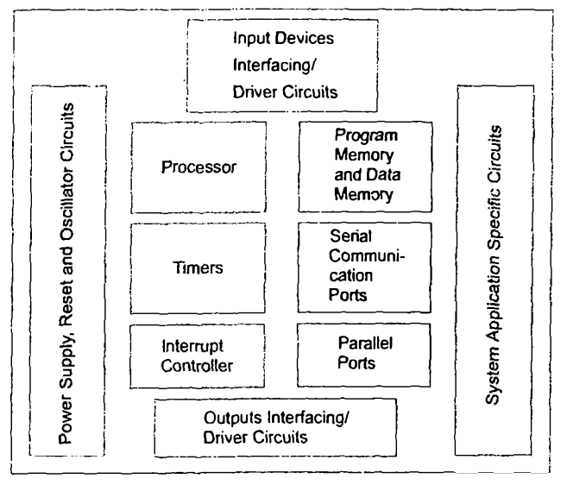
Activities
Unit 1
Overview of Embedded Systems
3. Simple Embedded System
3.2 Components of Embedded System
An embedded system is a system that has three main components embedded into it:
  It embeds hardware similar to a computer. Figure shows the units in the hardware of an embedded system.
  As its software usually embeds in the ROM or flash memory, it usually does not need a secondary hard disk and CD memory as in a computer.

Slide 15
Activities
Unit 1
Overview of Embedded Systems
3. Simple Embedded System
3.2 Components of Embedded System
  It embeds main application software. The application software may concurrently perform a series of tasks, processes, or threads.
  It embeds a real-time operating system (RTOS) that supervises the application software running on hardware and organizes access to a resource according to the priorities of tasks in the system.
  It provides a mechanism to let the processor run a process as scheduled and context-switch between the various processes.

Slide 16
Activities
Unit 1
Overview of Embedded Systems
3. Simple Embedded System
3.2 Components of Embedded System
  It sets the rules during the execution of the application software. (A small-scale embedded system may not embed the RTOS.)

Slide 17
Activities
Unit 1
Overview of Embedded Systems
3. Simple Embedded System
3.3 Why a PC is Not Considered an Embedded System?
  Broad Application Range: A PC supports a wide variety of applications, such as word processing, communication, printing, and more. This versatility means it’s designed to handle many different tasks, unlike an embedded system, which is designed for a specific application.
  Power Consumption: While low power consumption is important for embedded systems, it is not the primary design focus for PCs. PCs are designed for performance and versatility rather than minimizing power usage.
  Memory Flexibility: PCs have various types of memory, including RAM, ROM, and large secondary storage devices like hard disks and CD-ROMs. Users can upgrade or expand this memory as needed. In contrast, embedded systems have fixed memory tailored to their specific application.

Slide 18
Activities
Unit 1
Overview of Embedded Systems
3. Simple Embedded System
3.3 Why a PC is Not Considered an Embedded System?
  Application Flexibility: PCs can run multiple applications, and users can install new ones as needed. Embedded systems, however, are typically designed to run a specific application or set of tasks, with limited ability to change or add applications.
  Input Devices: PCs are used with a range of input devices like keyboards, mice, and modems. Embedded systems usually have more specialized or limited input options tailored to their specific functions.
  Reliability and Critical Use: While PCs need to be reliable, they are not usually part of critical systems where failure could have serious consequences. Embedded systems are often used in critical applications where high reliability is crucial.

Slide 19
Activities
Unit 1
Overview of Embedded Systems
3. Simple Embedded System
3.3 Why a PC is Not Considered an Embedded System?
  Performance and Timing: PCs are designed for high performance but usually do not have strict timing requirements. Embedded systems often have time-critical requirements and are designed to meet specific performance constraints related to their dedicated functions.
Considering Handheld Devices
Handheld devices like advanced mobile phones are increasingly used for general purposes, similar to PCs. However, their design shares similarities with embedded systems.
They are built with constraints on processor power, memory, size, and timing.
Despite supporting multiple applications, their core design principles align more closely with embedded systems.

Slide 20
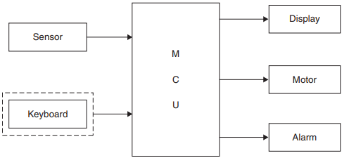
Activities
Unit 1
Overview of Embedded Systems
3. Simple Embedded System
3.4 Example of a Simple Embedded System
We'll consider a very simple example, as shown in Figure. In this system, a Microcontroller Unit (MCU) acts as the brain, functioning as a temperature monitor and controller.
System Flow
Temperature Reading: A sensor reads the temperature.
Analog to Digital Conversion: The MCU has an Analog-to-Digital Converter (ADC) that converts the temperature data to digital form.

Slide 21
Activities
Unit 1
Overview of Embedded Systems
3. Simple Embedded System
3.4 Example of a Simple Embedded System
Comparison and Control:
  The digital temperature data is compared to a reference temperature.
  If the temperature exceeds the allowed value, an alarm is triggered.
  The MCU also activates a cooling fan to reduce the temperature.
Temperature Display: The temperature is shown on a digital display.
Thus, the outputs of the system include:
  Display of the temperature value, Activation of an alarm, Control of a cooling fan motor. The input is simply the temperature sensor.

Slide 22
Activities
Unit 1
Overview of Embedded Systems
3. Simple Embedded System
3.4 Example of a Simple Embedded System - Working:
The system's program continuously measures the temperature at the sensor with a delay, T, between readings.
This delay is managed by a timer inside the MCU.
The ADC inside the MCU converts the analog temperature to a digital number.
The display is refreshed at the same rate as the temperature readings.
The program is written, tested, and stored in the ROM (usually flash ROM) of the MCU. It runs continuously.
The entire circuitry is mounted on a Printed Circuit Board (PCB), enclosed in a casing, and becomes a product. The user places this product in the desired area to measure temperature.

Slide 23
Activities
Unit 1
Overview of Embedded Systems
3. Simple Embedded System
3.4 Example of a Simple Embedded System - Updating the Program:
If the program needs to be updated, the designer has to intervene; the user cannot change the finished product. However, the product can have a user interface, such as a keyboard, allowing the user to change the reference temperature. This keyboard input can be used with a password (optional) to change settings.
Interrupt Handling: When a key is pressed on the keyboard, an Interrupt Service Routine (ISR) is activated to check the password and allow the user to change the reference temperature settings. This programming method, where a program continually runs in memory, is called the "superloop approach." The system accepts any aperiodic input through interrupts.

Slide 24
Activities
Unit 1
Overview of Embedded Systems
3. Simple Embedded System
3.4 Example of a Simple Embedded System - More Complex Systems:
Fore more complex systems, like a mobile phone, multiple functions are performed, such as handling voice calls, messaging, internet access, and media playback. Some applications are time-critical, while others are not.
Such complex systems require a "manager," typically an operating system (OS), to handle the various tasks and response times. Popular mobile phone operating systems include Symbian and Android.
Other complex systems, such as PDAs, telecom networks, and wireless sensor networks, also use operating systems.
Operating systems are necessary when system complexity, due to multiple tasks and critical response times, dictates their need.

Slide 25
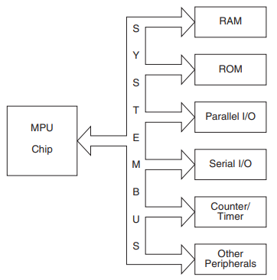
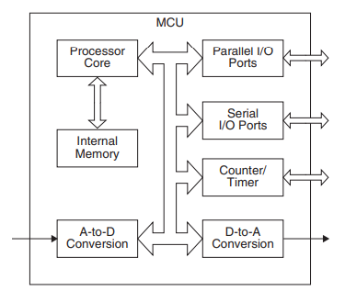
Activities
Unit 1
Overview of Embedded Systems
4. Microprocessor vs Microcontroller

Slide 26
Activities
Unit 1
Overview of Embedded Systems
4. Microprocessor vs Microcontroller
Processor serves as the brain of an embedded system. This simply means there should be a computational engine at the core of the system to make it intelligent. Two types of processor units are there-
  Microprocessor
  Microcontroller
4.1 Microprocessor Unit (MPU)
A processor like the 8086, or its advanced version, the Pentium, has very high computational capability but lacks the pins or internal architecture to interface with the external world.
For such microprocessors, external chips act as peripheral controllers. For example, to connect an LCD display to an MPU, an external parallel port IC is required.
For serial transmission, an external serial controller is necessary. External timers are needed for timing and counting, and memory can also be connected externally.

Slide 27
Activities
Unit 1
Overview of Embedded Systems
4. Microprocessor vs Microcontroller
4.1 Microprocessor Unit (MPU)
Figure shows an MPU chip connected to peripherals and memory, which are physically external to the chip.
MPUs are used as the core of general-purpose computation systems, where the emphasis is on computational power rather than interfacing capability.
A PC uses an MPU and a number of external chips together as a chipset, which acts as controllers for various peripherals.

Slide 28
Activities
Unit 1
Overview of Embedded Systems
4. Microprocessor vs Microcontroller
4.2 Microcontroller Unit (MCU)
See Figure. Here, the processing unit includes timers, parallel ports, serial ports, RAM, ROM, etc., within the same chip.
Thus, no external controller chips are needed.
Memory is also available inside the chip—the program code is burned into the internal ROM, and application code is run with the help of internal RAM. Therefore, this is essentially a self-contained single-chip computer.

Slide 29
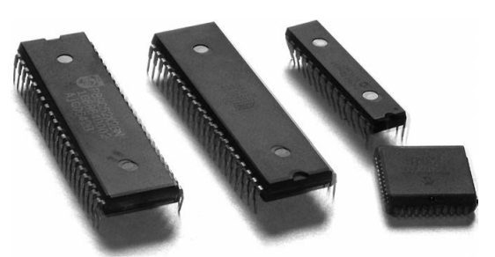
Activities
Unit 1
Overview of Embedded Systems
4. Microprocessor vs Microcontroller
4.2 Microcontroller Unit (MCU)
Popular microcontrollers include 8051, PIC, AVR, ARM, etc.
When an MCU includes many peripherals, allowing the design of a large system with these peripheral controllers, the chip is called a System on Chip (SoC).
Terms like ARM SoC and Cypress’s PSoC (Programmable System on Chip) are very popular in the embedded system market. Figure shows a photograph of a few MCU chips.

Slide 30
Activities
Unit 1
Overview of Embedded Systems
4. Microprocessor vs Microcontroller
4.3 Microprocessor vs. Microcontroller: A Comparative Overview
Microprocessor:
Definition:
  A microprocessor is a central processing unit (CPU) on a single integrated circuit (IC) designed to perform a variety of tasks by executing programmed instructions.
Components:
  Contains only the CPU.
  Requires external components such as RAM, ROM, timers, and I/O ports to function.
Usage:
  Used in general-purpose applications where flexibility is required.
  Commonly found in personal computers, laptops, and servers.

Slide 31
Activities
Unit 1
Overview of Embedded Systems
4. Microprocessor vs Microcontroller
4.3 Microprocessor vs. Microcontroller: A Comparative Overview
Microprocessor:
Memory:
  External memory for program and data storage, which allows for scalability in memory size.
Complexity and Cost:
  More complex and expensive due to the need for multiple external components.
Performance:
  Generally higher processing power and speed compared to microcontrollers.
Example: Intel Core i7, AMD Ryzen.

Slide 32
Activities
Unit 1
Overview of Embedded Systems
4. Microprocessor vs Microcontroller
4.3 Microprocessor vs. Microcontroller: A Comparative Overview
Microcontroller:
Definition:
  A microcontroller is a compact integrated circuit designed to govern a specific operation in an embedded system. It includes a CPU, memory, and I/O ports all on a single chip.
Components:
  Contains a CPU, RAM, ROM, timers, and I/O ports integrated into one chip.
Usage:
  Used in specific-purpose applications where control of devices is needed.
  Commonly found in embedded systems like home appliances, automobiles, medical devices, and industrial machines.

Slide 33
Activities
Unit 1
Overview of Embedded Systems
4. Microprocessor vs Microcontroller
4.3 Microprocessor vs. Microcontroller: A Comparative Overview
Microcontroller:
Memory:
  Limited built-in memory tailored for the specific application it controls.
Complexity and Cost:
  Less complex and generally cheaper due to the integration of all necessary components on one chip.
Performance:
  Lower processing power and speed compared to microprocessors but sufficient for control-oriented tasks.
Example: Arduino (ATmega328), ARM Cortex-M series.

Slide 34
Activities
Unit 1
Overview of Embedded Systems
4. Microprocessor vs Microcontroller
4.4 Microprocessor vs. Microcontroller: Comparison Table
Feature | Microprocessor | Microcontroller
Definition | Central Processing Unit (CPU) on a single IC | Compact IC for specific operations in embedded systems
Components | Contains only the CPU | Contains CPU, RAM, ROM, timers, and I/O ports
Usage | General-purpose applications | Specific-purpose applications in embedded systems
Memory | External memory for program and data storage | Built-in memory tailored for specific applications
Complexity and Cost | More complex and expensive due to external components | Less complex and generally cheaper due to integrated components
Performance | Higher processing power and speed | Lower processing power and speed, sufficient for control tasks
Example | Intel Core i7, AMD Ryzen | Arduino (ATmega328), ARM Cortex-M series

Slide 35
Activities
Unit 1
Overview of Embedded Systems
4. Microprocessor vs Microcontroller
4.5 Microprocessor vs. Microcontroller: Key Differences
Key Differences | Microprocessor | Microcontroller
Integration | Requires external components for memory and I/O functions. | All components are integrated into one chip.
Application | Suitable for complex, general-purpose tasks requiring high processing power. | Ideal for specific, control-oriented tasks in embedded systems.
Cost and Complexity | Higher cost and complexity due to external components. | Lower cost and complexity with integrated components.
Memory | External and scalable memory. | Built-in and limited memory.

Slide 36
Activities
Unit 1
Overview of Embedded Systems
4. Microprocessor vs Microcontroller
4.5 Microprocessor vs. Microcontroller: Key Differences
Key Differences | Microprocessor | Microcontroller
Integration | Requires external components for memory and I/O functions. | All components are integrated into one chip.
Application | Suitable for complex, general-purpose tasks requiring high processing power. | Ideal for specific, control-oriented tasks in embedded systems.
Cost and Complexity | Higher cost and complexity due to external components. | Lower cost and complexity with integrated components.
Memory | External and scalable memory. | Built-in and limited memory.

Slide 37
Activities
Unit 1
Overview of Embedded Systems
5. Classification of MCUs
We can classify Microcontroller Units (MCUs) based on their data word lengths, which directly relate to the complexity of the operations they can handle.
Complex operations, such as image and video processing, often require large amounts of data, wider data buses, and higher clock rates.
Here's how MCUs are classified on this basis:
  4-bit MCUs
  8-bit MCUs
  16-bit MCUs
  32-bit MCUs

Slide 38
Activities
Unit 1
Overview of Embedded Systems
5. Classification of MCUs
i) 4-bit MCUs
Applications: Designed for very simple tasks involving minimal computation, such as basic toys and devices that only use switch inputs and direct actuation. These MCUs are sufficient for applications that do not need to handle large volumes of data.
Characteristics: 4-bit MCUs feature narrow data buses and have very limited memory space, often ranging from a few bytes to a couple of kilobytes. This small memory is sufficient for storing simple programs and a minimal amount of data.
Memory Space: Typically, these MCUs have up to 4 KB of memory, which includes both program memory (ROM/Flash) and data memory (RAM).

Slide 39
Activities
Unit 1
Overview of Embedded Systems
5. Classification of MCUs
ii) 8-bit MCUs
Applications: The most commonly used MCUs, suitable for moderately complex operations. They are widely deployed in various applications due to their balance of simplicity and capability.
Popular Families: The 8051 family, originally developed by Intel, is one of the most popular 8-bit MCU families, now manufactured by various companies. Microchip's PIC series is another well-known family, offering a wide range of models with varying capabilities. The PIC series includes not only 8-bit MCUs but also 16-bit and 32-bit versions, making it versatile and attractive for different levels of complexity.
Memory Space: 8-bit MCUs generally come with memory spaces ranging from a few kilobytes to tens of kilobytes. For example, the 8051 MCUs typically have 4 KB to 64 KB of ROM and up to 256 bytes to 1 KB of RAM.

Slide 40
Activities
Unit 1
Overview of Embedded Systems
5. Classification of MCUs
iii) 16-bit MCUs
Applications: These MCUs are used when more computational power is needed than what 8-bit MCUs can provide, but where 32-bit might be overkill. They offer a middle ground in terms of performance, memory, and power consumption.
Popular Models: Examples include Intel's 8096 and 80196, and some versions of the PIC series. Texas Instruments' MSP430 series is a notable 16-bit MCU known for its very low power dissipation, making it a strong competitor in markets where energy efficiency is critical.
Memory Space: 16-bit MCUs typically feature memory spaces ranging from tens of kilobytes to hundreds of kilobytes. The MSP430 series, for instance, often has up to 256 KB of Flash memory and 16 KB of RAM, which allows for more sophisticated programs and data handling.

Slide 41
Activities
Unit 1
Overview of Embedded Systems
5. Classification of MCUs
iv) 32-bit MCUs
Applications: These MCUs are used in highly complex applications that require significant processing power, such as image and video processing. They are essential in modern devices like smartphones, iPods, and PDAs, where low power consumption, high speed, and strong computing capabilities are critical.
Popular Models: The ARM architecture is the most widely used 32-bit MCU today, dominating the market for complex, high-performance embedded applications.
Memory Space: 32-bit MCUs usually come with memory spaces ranging from hundreds of kilobytes to several megabytes. Advanced models, like those based on the ARM Cortex-M series, can have up to 2 MB or more of Flash memory and 512 KB or more of RAM, supporting large and complex software applications.

Slide 42
Activities
Unit 1
Overview of Embedded Systems
5. Classification of MCUs
Feature | 4-bit MCU | 8-bit MCU | 16-bit MCU | 32-bit MCU
Architecture | 4-bit data bus | 8-bit data bus | 16-bit data bus | 32-bit data bus
Typical Applications | Simple toys, basic controls | Home automation, small-scale projects | Industrial control, low-power devices | Advanced robotics, multimedia, IoT
Processing Power | Very limited | Moderate | Higher than 8-bit | High, suitable for complex tasks
Memory Space | Up to 4 KB | 4 KB to 64 KB | Tens to hundreds of KB | Hundreds of KB to several MB
Clock Speed | Low (typically a few MHz) | Low to moderate (up to 20 MHz) | Moderate (20-50 MHz) | High (50 MHz to several GHz)
Power Consumption | Very low | Low | Moderate | Variable, depending on application
Ease of Use | Simple, for basic tasks | Simple to moderate | Moderate complexity | More complex, requires advanced knowledge
Popular Examples | Rare in modern use | 8051, PIC16, ATmega328P (Arduino Uno) | MSP430, PIC24 | ARM Cortex-M, Raspberry Pi (SoC)
Cost | Very low | Low | Moderate | Higher, varies with capabilities
Suitability for Real-Time | Limited | Good for simple real-time tasks | Good | Suitable for advanced real-time tasks

Slide 43
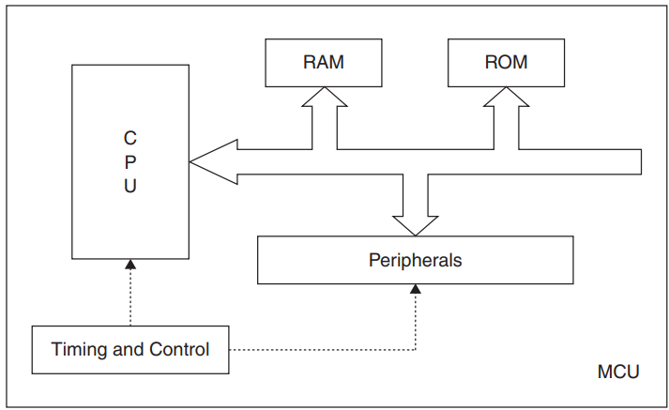
Activities
Unit 1
Overview of Embedded Systems
6. Microcontroller Unit
A processing unit is needed for an embedded system. An ‘embedded processor’ which is another name for a ‘microcontroller unit’, is used at the heart of the system design. There is a processor part inside the MCU block this is the CPU or the computing engine of the MCU. Figure shows this.
The other blocks inside it are memory and peripheral controllers.
The number and kind of peripheral controllers is not standard various MCUs have different sets of peripherals, but there are some peripherals which are more or less a standard feature-like timers and the serial communication interface.

Slide 44
Activities
Unit 1
Overview of Embedded Systems
6. Microcontroller Unit - Processor
The processor in a Microcontroller Unit (MCU) acts as the "brain" of the system. It’s the central part that does all the calculations and controls the other components (called peripherals).
Here's a breakdown of the key points in simple terms:
Processor's Role: The processor is like the command center of the MCU. It handles all the necessary calculations and makes decisions to control the peripherals, which are the other parts of the MCU that manage specific tasks (like communication or timing).
Internal Data and Address Buses: Since the processor, memory, and peripheral controllers are all inside the same chip, the pathways (called data bus and address bus) that carry information between them are internal. This means everything happens within the chip, making it faster and more efficient.

Slide 45
Activities
Unit 1
Overview of Embedded Systems
6. Microcontroller Unit - Processor
Performance Factors: How well the processor performs depends on several things:
  Instruction Set Architecture (ISA): This is a set of instructions that the processor understands and can execute. The ISA is crucial because it defines how the processor works with data, how it communicates with memory, and how it handles various tasks. It affects how complex and fast the processor can be.
  Data Bus Width: This refers to how much data the processor can handle at once. A wider data bus can move more information at a time, improving performance.
  Addressing Space: This determines how much memory the processor can access. More addressing space means the processor can work with larger amounts of data.

Slide 46
Activities
Unit 1
Overview of Embedded Systems
6. Microcontroller Unit - Processor
Instruction Set Architecture (ISA): The ISA is like the language the processor speaks. It includes:
  Native Data Types: The types of data the processor can work with directly.
  Instruction Registers: Special storage areas inside the processor where it keeps instructions and data temporarily.
  Addressing Modes: The ways the processor can access data in memory.
  Memory Architecture: How memory is organized and used by the processor.
  Interrupt Handling: How the processor deals with interruptions, such as responding to external events while running a program.

Slide 47
Activities
Unit 1
Overview of Embedded Systems
6. Microcontroller Unit - Processor
In summary, the processor is the core component of an MCU that executes commands and controls other parts of the system. Its performance is influenced by its instruction set, the width of the data bus, and how much memory it can address. The Instruction Set Architecture (ISA) is crucial as it defines how the processor operates and how it interacts with programs.

Slide 48
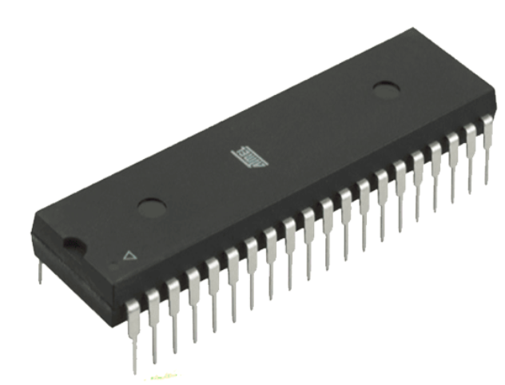
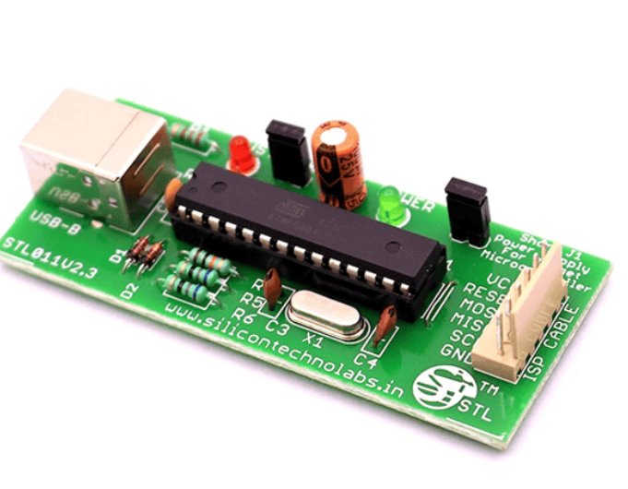
Activities
Unit 1
Overview of Embedded Systems
7. 8-bit Microcontroller Unit - 8051
The 8051 microcontroller, originally developed by Intel in 1980, is one of the most successful and widely used microcontrollers in the world.
It belongs to the MCS-51 family and has become a standard in the industry due to its flexibility, ease of use, and availability from multiple manufacturers.
The 8051 is known for its simplicity and the ability to perform a wide range of tasks, making it ideal for embedded systems that require real-time control.

Slide 49
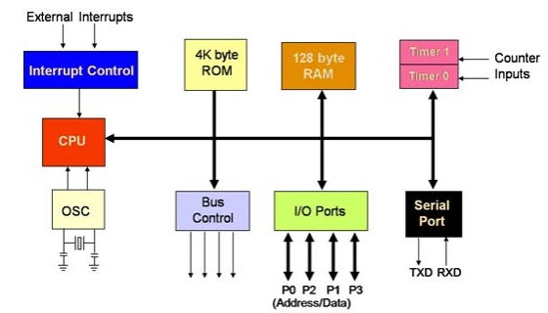
Activities
Unit 1
Overview of Embedded Systems
7. 8-bit Microcontroller Unit - Architecture of the 8051
The 8051 microcontroller is built around an 8-bit Central Processing Unit (CPU) and includes several integrated components that make it a self-contained system on a chip (SoC). Here's a breakdown of its key architectural features:
8-bit CPU:
  The CPU is the core of the 8051 and is responsible for executing instructions and controlling the operation of the microcontroller.
  Being an 8-bit processor, the 8051 handles data in 8-bit chunks, meaning it can process 8 bits of data at a time. This is suitable for many control-oriented applications.

Slide 50
Activities
Unit 1
Overview of Embedded Systems
7. 8-bit Microcontroller Unit - Architecture of the 8051
Memory:
ROM (Read-Only Memory): The 8051 typically includes 4KB of on-chip ROM, which is used to store the program code permanently. This program is written by the developer and is executed by the CPU when the microcontroller is powered on.
RAM (Random Access Memory): The 8051 has 128 bytes of on-chip RAM for temporary data storage during operation. This RAM is used to store variables, temporary data, and the stack (a special area for managing function calls and local variables).
External Memory: The 8051 can also interface with external memory if the internal memory is insufficient for the application. The address bus is 16 bits wide, allowing the microcontroller to access up to 64KB of external memory.

Slide 51
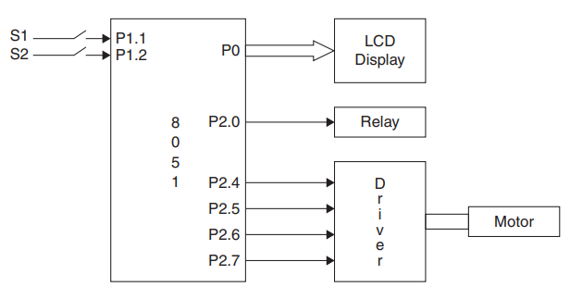
Activities
Unit 1
Overview of Embedded Systems
7. 8-bit Microcontroller Unit - Architecture of the 8051
Input/Output Ports:
The 8051 has four general-purpose input/output (I/O) ports named P0, P1, P2, and P3. Each port is 8 bits wide, meaning it consists of 8 pins that can be used as inputs or outputs.
These ports allow the 8051 to interface with external devices such as sensors, actuators, displays, and other peripherals. For example, Port 0 (P0) can be used as both a data bus for external memory and as general-purpose I/O.

Slide 52
Activities
Unit 1
Overview of Embedded Systems
7. 8-bit Microcontroller Unit - Architecture of the 8051
Timers and Counters:
The 8051 includes two 16-bit timers/counters, named Timer 0 and Timer 1. These can be used to generate time delays, measure time intervals, or count events.
Timers are crucial for tasks that require precise timing, such as generating PWM signals for motor control or managing communication protocols.
Serial Communication:
The 8051 has an integrated UART (Universal Asynchronous Receiver/Transmitter) for serial communication, allowing it to send and receive data over serial lines.
This feature is useful for connecting the 8051 to other microcontrollers, computers, or communication devices like modems.

Slide 53
Activities
Unit 1
Overview of Embedded Systems
7. 8-bit Microcontroller Unit - Architecture of the 8051
Interrupt System:
The 8051 supports five interrupt sources: two external interrupts (INT0 and INT1), two timer interrupts (Timer 0 and Timer 1), and one serial communication interrupt.
Interrupts allow the 8051 to respond quickly to important events, such as a signal from a sensor or data arriving on a communication line, without constantly checking for these events in the main program (polling).
Special Function Registers (SFRs):
The 8051 includes a set of Special Function Registers (SFRs) that control various aspects of the microcontroller's operation. These registers are used to configure the I/O ports, timers, serial communication, and other features.
SFRs are accessible by the CPU and are essential for programming the 8051 to perform specific tasks.

Slide 54
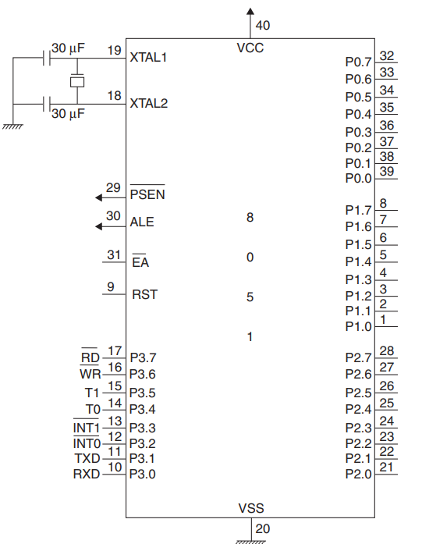
Activities
Unit 1
Overview of Embedded Systems
7. 8-bit Microcontroller Unit - Pin Configuration of the 8051
The 8051 comes in a 40-pin Dual Inline Package (DIP), and each pin has a specific function. Here are the main pin functions:
VCC and GND: Power supply pins. VCC is typically 5V, and GND is the ground.
P0 (Port 0): A dual-purpose port that can be used as an 8-bit general-purpose I/O port or as the lower 8 bits of the address/data bus when interfacing with external memory.
P1 (Port 1): An 8-bit general-purpose I/O port.
P2 (Port 2): A dual-purpose port that can be used as an 8-bit general-purpose I/O port or as the upper 8 bits of the address bus when interfacing with external memory.

Slide 55
Activities
Unit 1
Overview of Embedded Systems
7. 8-bit Microcontroller Unit - Pin Configuration of the 8051
P3 (Port 3): An 8-bit general-purpose I/O port with additional functions like serial communication (RXD, TXD), external interrupts (INT0, INT1), and control signals for external memory (RD, WR).

Slide 56
Activities
Unit 1
Overview of Embedded Systems
7. 8-bit Microcontroller Unit - Popular Applications of the 8051
The 8051 is used in a wide range of applications due to its versatility and simplicity:
Home Appliances: The 8051 is commonly found in devices like washing machines, microwave ovens, and air conditioners, where it controls functions like timing, motor control, and user interfaces.
Industrial Automation: It is used in factory automation systems to control processes, manage sensors and actuators, and handle communication between different parts of a system.
Automotive Systems: The 8051 is used in various vehicle subsystems, such as engine control, braking systems, and dashboard displays.
Consumer Electronics: Devices like remote controls, calculators, and handheld gaming consoles often use the 8051 for processing user inputs and controlling outputs.
Medical Devices: The 8051 is used in medical instruments for monitoring, data logging, and control tasks, such as in blood glucose meters or portable diagnostic tools.

Slide 57
Activities
Unit 1
Overview of Embedded Systems
7. 8-bit Microcontroller Unit - Summary
Summary
The 8051 microcontroller is a powerful, flexible, and widely-used 8-bit MCU that has become a standard in embedded systems.
Its architecture includes a CPU, memory, I/O ports, timers, serial communication, and an interrupt system, all integrated into a single chip.
This makes it ideal for a wide variety of applications, from simple home appliances to complex industrial control systems.
Despite being developed decades ago, the 8051 remains relevant and is still widely used due to its simplicity, reliability, and the vast ecosystem of tools and resources available for it.

Slide 58
Activities
Unit 1
Overview of Embedded Systems
8. Arduino Uno – 8 bit MCU
The Arduino Uno, a widely used microcontroller board, is based on the ATmega328P microcontroller, which is an 8-bit MCU. Let's explore the bit architecture of the Arduino Uno in a similar manner to the previous classification:
Applications: The Arduino Uno is ideal for educational purposes, prototyping, and small-scale embedded systems. It is well-suited for moderately complex operations, such as reading sensor data, controlling motors, handling simple communications, and performing basic computations. Due to its user-friendly environment and extensive community support, the Arduino Uno is a popular choice for beginners and hobbyists.
Microcontroller: The Arduino Uno is powered by the ATmega328P microcontroller, which belongs to the AVR family of 8-bit MCUs.
Characteristics: As an 8-bit MCU, the ATmega328P processes 8 bits of data at a time, which is sufficient for many simple to moderately complex embedded applications. It offers a balance between performance and simplicity, making it accessible for a wide range of projects.

Slide 59
Activities
Unit 1
Overview of Embedded Systems
8. Arduino Uno – 8 bit MCU
Memory Space:
Flash Memory (Program Memory): The ATmega328P features 32 KB of Flash memory, which is used to store the program code. This amount of memory is adequate for many applications, allowing for the implementation of reasonably complex logic and control systems.
SRAM (Data Memory): The microcontroller includes 2 KB of SRAM, which is used for storing variables and temporary data during program execution. While this is a relatively small amount of memory, it is sufficient for handling the data requirements of many typical Arduino projects.
EEPROM (Non-Volatile Memory): The ATmega328P also includes 1 KB of EEPROM, which is used for storing data that needs to persist even when the power is turned off. This can be useful for saving settings or calibration data.

Slide 60
Activities
Unit 1
Overview of Embedded Systems
8. Arduino Uno – 8 bit MCU
Comparison with Other 8-bit MCUs
Memory Space: The Arduino Uno’s 32 KB of Flash memory is on the higher side for 8-bit MCUs, making it more capable than some older 8-bit MCUs like the 8051 family, which might have as little as 4 KB to 64 KB of Flash memory. The 2 KB of SRAM, however, is quite typical for 8-bit MCUs, providing sufficient space for handling variables and runtime data.
Ease of Use: The Arduino ecosystem enhances the usability of the ATmega328P by providing a simplified development environment (Arduino IDE), a vast library of ready-to-use code, and extensive documentation. This makes the Arduino Uno a practical choice for beginners and hobbyists, even though it operates with an 8-bit architecture.

Slide 61
Activities
Unit 1
Overview of Embedded Systems
8. Arduino Uno – 8 bit MCU
Applications and Limitations
Applications: The Arduino Uno is commonly used in projects like home automation, robotics, sensor monitoring, and educational kits. Its 8-bit architecture, combined with the available memory, supports tasks like reading and writing digital and analog signals, basic communication protocols (I2C, SPI, UART), and simple decision-making processes.
Limitations: Despite its versatility, the Arduino Uno’s 8-bit architecture and limited memory space restrict its ability to handle more complex tasks, such as image processing, high-speed data acquisition, or running large, sophisticated algorithms. For such applications, a 16-bit or 32-bit MCU would be more appropriate.

Slide 62
Activities
Unit 1
Overview of Embedded Systems
8. Arduino Uno – 8 bit MCU
Summary
In summary, the Arduino Uno, with its 8-bit ATmega328P microcontroller, is a robust and accessible platform for a wide range of embedded applications, especially where moderate complexity and ease of use are key considerations.
Its memory space and processing capabilities are well-suited to many common tasks in the maker and educational communities, though it may fall short in handling more demanding applications that require higher data throughput or more extensive memory.

Slide 63
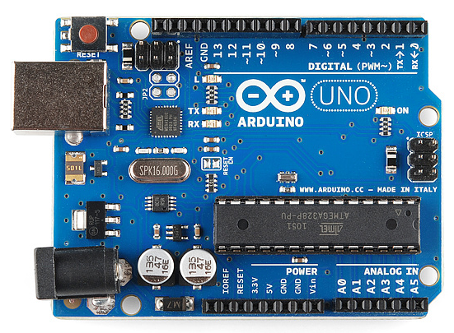
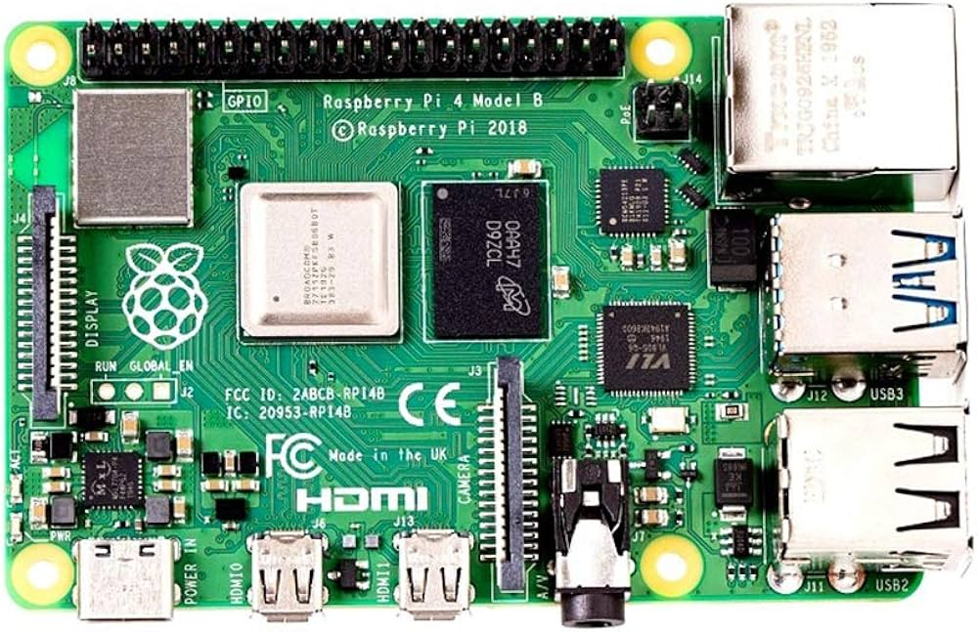
Activities
Unit 1
Overview of Embedded Systems
8. Raspberry Pi (32-bit/64-bit SoC)
The Raspberry Pi is a series of small single-board computers that are much more powerful and versatile compared to microcontroller-based platforms like the Arduino.
Unlike the Arduino Uno, which is based on an 8-bit microcontroller, the Raspberry Pi uses a 32-bit or 64-bit system-on-chip (SoC) with significantly greater processing power, memory, and capabilities.
Let’s explore the architecture and capabilities of the Raspberry Pi in the context of its bit architecture, similar to how we analyzed the Arduino Uno:

Slide 64
Activities
Unit 1
Overview of Embedded Systems
8. Raspberry Pi (32-bit/64-bit SoC)
Applications:
  The Raspberry Pi is capable of running a full Linux operating system, making it suitable for a wide range of applications that go far beyond simple embedded systems.
  These include desktop computing, software development, media centers, web servers, IoT applications, robotics, and more complex tasks like image processing, machine learning, and data analysis.
System-on-Chip (SoC):
  The core of most Raspberry Pi models is a Broadcom SoC, which typically includes a 32-bit ARM Cortex-A processor (in older models) or a 64-bit ARM Cortex-A72 processor (in more recent models like the Raspberry Pi 4).

Slide 65
Activities
Unit 1
Overview of Embedded Systems
8. Raspberry Pi (32-bit/64-bit SoC)
Characteristics:32-bit/64-bit Architecture:
  The ARM Cortex-A processors in Raspberry Pi devices can handle either 32-bit or 64-bit instructions, depending on the specific model and the operating system used.
  This architecture enables the Raspberry Pi to perform complex computational tasks that are far beyond the capabilities of 8-bit microcontrollers.
Multi-Core Processing:
  Unlike microcontrollers, the Raspberry Pi typically features multi-core processors (e.g., a quad-core or even octa-core setup), allowing it to handle multiple tasks simultaneously, greatly increasing its versatility and performance.

Slide 66
Activities
Unit 1
Overview of Embedded Systems
8. Raspberry Pi (32-bit/64-bit SoC)
Memory Space:
RAM: The Raspberry Pi models come with varying amounts of RAM, depending on the version:
  Raspberry Pi Zero: 512 MB of RAM.
  Raspberry Pi 3 Model B: 1 GB of RAM.
  Raspberry Pi 4 Model B: Available with 2 GB, 4 GB, or even 8 GB of RAM.
Storage: Unlike microcontrollers that typically have onboard Flash memory, the Raspberry Pi uses a microSD card as its primary storage medium, which can range from a few GB to several hundred GB. This allows the Raspberry Pi to store large operating systems, applications, and data.
Cache Memory: The processors in the Raspberry Pi also include several levels of cache memory (L1, L2, sometimes L3), which help speed up processing by temporarily storing frequently accessed data.

Slide 67
Activities
Unit 1
Overview of Embedded Systems
8. Raspberry Pi (32-bit/64-bit SoC)
Comparison with Microcontrollers (like Arduino)
Processing Power: The Raspberry Pi’s ARM Cortex processors are significantly more powerful than the 8-bit microcontroller used in the Arduino Uno. This difference allows the Raspberry Pi to run complex operating systems and software applications, manage multitasking environments, and perform computationally intensive tasks.
Memory: The RAM available on the Raspberry Pi is orders of magnitude larger than the SRAM found on microcontrollers. This allows for the execution of larger programs, the handling of large datasets, and the running of memory-intensive applications.
Storage: The ability to use a microSD card or external storage devices gives the Raspberry Pi flexibility in storing large amounts of data, something that microcontrollers with their limited onboard memory cannot do.

Slide 68
Activities
Unit 1
Overview of Embedded Systems
8. Raspberry Pi (32-bit/64-bit SoC)
Applications: The Raspberry Pi can be used for a wide array of applications, including but not limited to:
  General-Purpose Computing: Acting as a low-cost, fully functional desktop computer.
  Educational Purposes: Teaching programming and computer science concepts.
  Media Centers: Running software like Kodi to serve as a home media center.
  IoT Devices: Collecting and processing data in Internet of Things applications.
  Robotics: Controlling complex robots with vision processing and autonomous navigation.
  Home Automation: Managing smart home devices and automating various tasks.

Slide 69
Activities
Unit 1
Overview of Embedded Systems
8. Raspberry Pi (32-bit/64-bit SoC)
Limitations:
  Despite its power, the Raspberry Pi is not a real-time system and is not suitable for applications where precise timing is critical.
  For tasks requiring real-time processing, a microcontroller might still be preferred.
  Additionally, while the Raspberry Pi is versatile, it can be overkill for very simple tasks where an 8-bit or 16-bit microcontroller would suffice.

Slide 70
Activities
Unit 1
Overview of Embedded Systems
8. Raspberry Pi (32-bit/64-bit SoC)
Summary:
  The Raspberry Pi, with its 32-bit or 64-bit ARM Cortex-A processor, offers significantly more processing power, memory, and flexibility than an 8-bit microcontroller like the Arduino Uno.
  It is capable of running a full operating system, executing complex applications, and handling large amounts of data, making it suitable for a wide range of more advanced and resource-intensive applications.
  However, for simple, real-time control tasks, a microcontroller like the Arduino Uno might still be the better choice due to its simplicity, lower power consumption, and real-time capabilities.

Slide 71
Activities
Unit 1
Overview of Embedded Systems
9. Arduino Uno Vs Raspberry Pi
  Arduino Uno is best suited for simple, control-oriented projects like sensor reading, motor control, and other basic embedded systems tasks. It's great for beginners and projects that require low power and real-time operations.
  Raspberry Pi is a more powerful and versatile platform capable of running a full operating system, making it suitable for more complex projects like robotics, home automation, and media centers. It's ideal for tasks that require multitasking, networking, and more computational power.

Slide 72
Activities
Unit 1
Overview of Embedded Systems
9. Arduino Uno Vs Raspberry Pi
Feature | Arduino Uno | Raspberry Pi
Type | Microcontroller Board | Single-Board Computer
Processor | ATmega328P (8-bit microcontroller) | ARM Cortex-A series (e.g., ARM Cortex-A53)
Clock Speed | 16 MHz | 700 MHz to 1.5 GHz (depending on the model)
Memory (RAM) | 2 KB SRAM | 512 MB to 8 GB (depending on the model)
Storage | No onboard storage, programs are stored on Flash memory | SD card for OS and storage
Operating System | No operating system, runs a single program | Runs a full operating system (e.g., Linux, Raspbian)
Power Consumption | Low power (5V, 20-50 mA) | Higher power consumption (5V, 2-3 A)
Input/Output (I/O) | 14 digital I/O pins, 6 analog input pins | 40 GPIO pins, USB ports, HDMI, Ethernet, etc.
Programming Language | Primarily C/C++ (Arduino IDE) | Multiple languages (Python, C++, Java, etc.)
Ease of Use | Easier for beginners, ideal for simple projects | More complex, suited for advanced projects and multitasking
Networking | No built-in networking capabilities | Built-in Ethernet and Wi-Fi (in newer models)
Use Cases | Simple control systems, sensors, and actuators | Complex projects like web servers, media centers, IoT devices

Slide 73
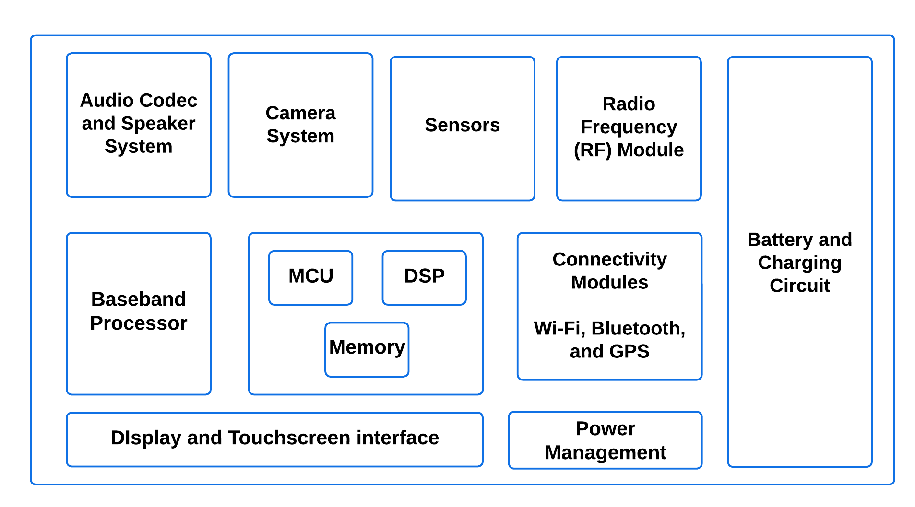
Activities
Unit 1
Overview of Embedded Systems
10. Functional blocks of a mobile phone

Slide 74
Activities
Unit 1
Overview of Embedded Systems
10. Functional blocks of a mobile phone
A mobile phone is a complex device made up of several functional blocks, each serving a specific purpose. Here's a technical yet simple breakdown:
1. Power Management Unit (PMU)
Function: Manages the power supply to the phone's components. It regulates voltage levels and controls power distribution to different parts like the CPU, screen, and sensors.
Key Components: Battery, charging circuit, voltage regulators.
2. Central Processing Unit (CPU)
Function: Acts as the brain of the phone. It executes instructions from software applications and controls other hardware components. The CPU handles tasks like running apps, processing data, and managing system resources.
Key Components: Processor cores, cache memory.

Slide 75
Activities
Unit 1
Overview of Embedded Systems
10. Functional blocks of a mobile phone
3. Memory (RAM and Storage)
Function: RAM temporarily stores data that the CPU needs to access quickly, like running apps. Storage (ROM or Flash Memory) holds the phone's operating system, apps, and user data like photos and videos.
Key Components: RAM chips, flash memory chips.
4. Display and Touchscreen Interface
Function: The display shows the graphical user interface, while the touchscreen allows users to interact with the phone by touching the screen.
Key Components: LCD or OLED display panel, touch sensor layers.

Slide 76
Activities
Unit 1
Overview of Embedded Systems
10. Functional blocks of a mobile phone
5. Baseband Processor
Function: Manages all communication functions, including voice calls, data, and text messaging. It handles signal processing for cellular networks (e.g., 4G, 5G).
Key Components: Modem, radio transceiver.
6. Radio Frequency (RF) Module
Function: Handles wireless communication, including cellular, Wi-Fi, Bluetooth, and GPS signals. It converts digital signals from the phone into radio waves and vice versa.
Key Components: RF transceivers, antennas, filters.

Slide 77
Activities
Unit 1
Overview of Embedded Systems
10. Functional blocks of a mobile phone
7. Audio Codec and Speaker System
Function: Converts digital audio signals to analog signals for speakers and vice versa for the microphone. It manages audio input and output, including calls and media playback.
Key Components: Digital-to-analog converter (DAC), analog-to-digital converter (ADC), speakers, microphones.
8. Camera System
Function: Captures images and videos. It consists of sensors that detect light and convert it into electrical signals, which are then processed into images.
Key Components: Image sensors (CMOS), lenses, image signal processor (ISP).

Slide 78
Activities
Unit 1
Overview of Embedded Systems
10. Functional blocks of a mobile phone
9. Sensors
Function: Provide data to the phone about its environment and user interactions. Common sensors include accelerometers (detects movement), gyroscopes (detects orientation), proximity sensors, and ambient light sensors.
Key Components: Accelerometer, gyroscope, proximity sensor, light sensor.
10. Connectivity Modules
Function: Facilitate connections to networks and other devices, including Wi-Fi, Bluetooth, and GPS. These modules ensure the phone can connect to the internet, pair with other devices, and provide location services.
Key Components: Wi-Fi module, Bluetooth module, GPS receiver.

Slide 79
Activities
Unit 1
Overview of Embedded Systems
10. Functional blocks of a mobile phone
11. Battery and Charging Circuit
Function: Stores energy to power the phone. The charging circuit controls how the battery is charged and ensures it operates safely.
Key Components: Lithium-ion battery, charging IC, power management circuits.
12. Operating System (OS)
Function: Software that manages hardware resources and provides a platform for applications to run. The OS coordinates the phone's operations and provides user interface elements.
Key Components: Kernel, system libraries, user interface framework.
Each of these functional blocks works together to make a mobile phone operate smoothly, enabling communication, media consumption, and a wide range of other functions.

Slide 80
Activities
Unit 1
Overview of Embedded Systems
11. Embedded Processing Unit of Mobile Phones
The embedded processing part of a mobile phone is crucial for managing the device's various tasks and functions in an efficient, low-power environment. This part primarily involves the Central Processing Unit (CPU) and its associated components, which are designed to handle specific operations that are fundamental to the phone's functionality.
1. Central Processing Block:
This block is at the heart of the phone's processing capabilities. It typically includes:
ARM Core Processors: These are general-purpose processors based on ARM architecture, which is popular for its efficiency and performance in mobile devices. Modern phones often use single or dual-core ARM processors, though some advanced models may use more cores.
Co-processors: These are specialized processors that assist the main ARM core by handling specific tasks, particularly signal processing. For example, tasks like processing audio, video, or handling communications can be offloaded to these co-processors, freeing up the main processor for other tasks.

Slide 81
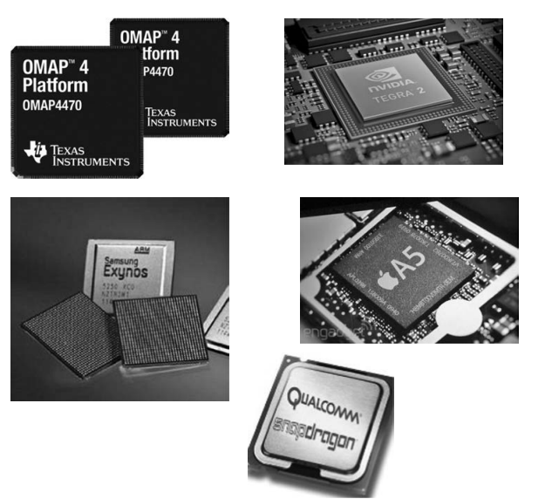
Activities
Unit 1
Overview of Embedded Systems
11. Embedded Processing Unit of Mobile Phones
Popular SoC

Slide 82
Activities
Unit 1
Overview of Embedded Systems
11. Embedded Processing Unit of Mobile Phones
2. System-on-Chip (SoC)
The SoC (System-on-Chip) is a crucial component that integrates multiple functions into a single chip. In modern smartphones, the SoC handles not just the main processing tasks but also manages microcontroller unit (MCU) tasks and digital signal processing (DSP) applications.
MCU: The microcontroller unit manages low-level operations, like interfacing with sensors or controlling the power management.
DSP: The digital signal processor focuses on tasks like audio processing, video decoding, or enhancing images.
3. Capabilities of Modern Processors
The processors used in today's smartphones are incredibly powerful, capable of running full operating systems like Linux and Android. These operating systems enable the phone to perform a wide range of tasks, from running apps to handling complex multitasking, similar to what a personal computer (PC) does.

Slide 83
Activities
Unit 1
Overview of Embedded Systems
11. Embedded Processing Unit of Mobile Phones
4. Popular Mobile Processors
Several companies produce the powerful processors used in smartphones. Some well-known examples include:
Texas Instruments’ OMAP: Known for its strong performance in multimedia processing.
Samsung’s Exynos: Often used in Samsung’s own smartphones, offering a balance of power and efficiency.
Qualcomm’s Snapdragon: One of the most popular mobile processors, widely used across many brands for its high performance and advanced features.
Apple’s Ax Series: Custom-designed processors that power iPhones, known for their seamless integration with Apple’s software.
Nvidia’s Tegra: Initially popular in mobile gaming devices, offering strong graphics processing capabilities.
Intel’s Medfield: Intel’s attempt to enter the mobile market, offering x86 architecture for mobile devices.

Slide 84
Activities
Unit 1
Overview of Embedded Systems
11. Embedded Processing Unit of Mobile Phones
Conclusion
In summary, the embedded processing block of a smartphone is highly sophisticated, combining general-purpose ARM cores with specialized co-processors on a single chip (SoC). This enables modern phones to perform a vast array of tasks, often rivaling the capabilities of personal computers, and is powered by some of the most advanced processors available from leading tech companies.

